Slide 1
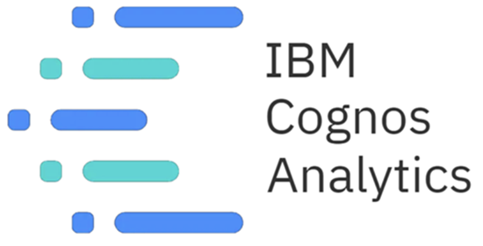

Slide 2
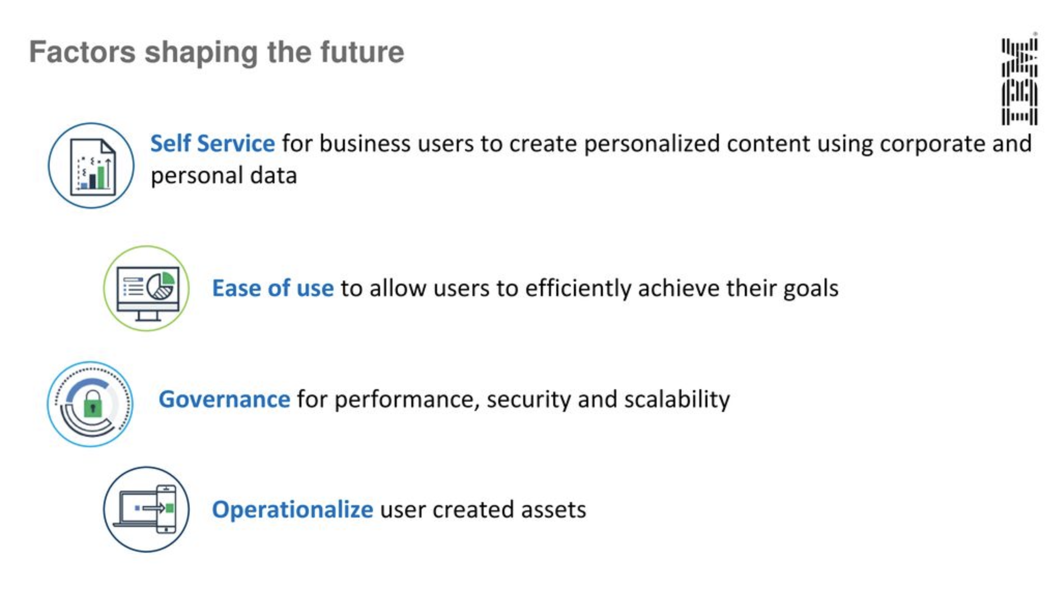

Slide 3
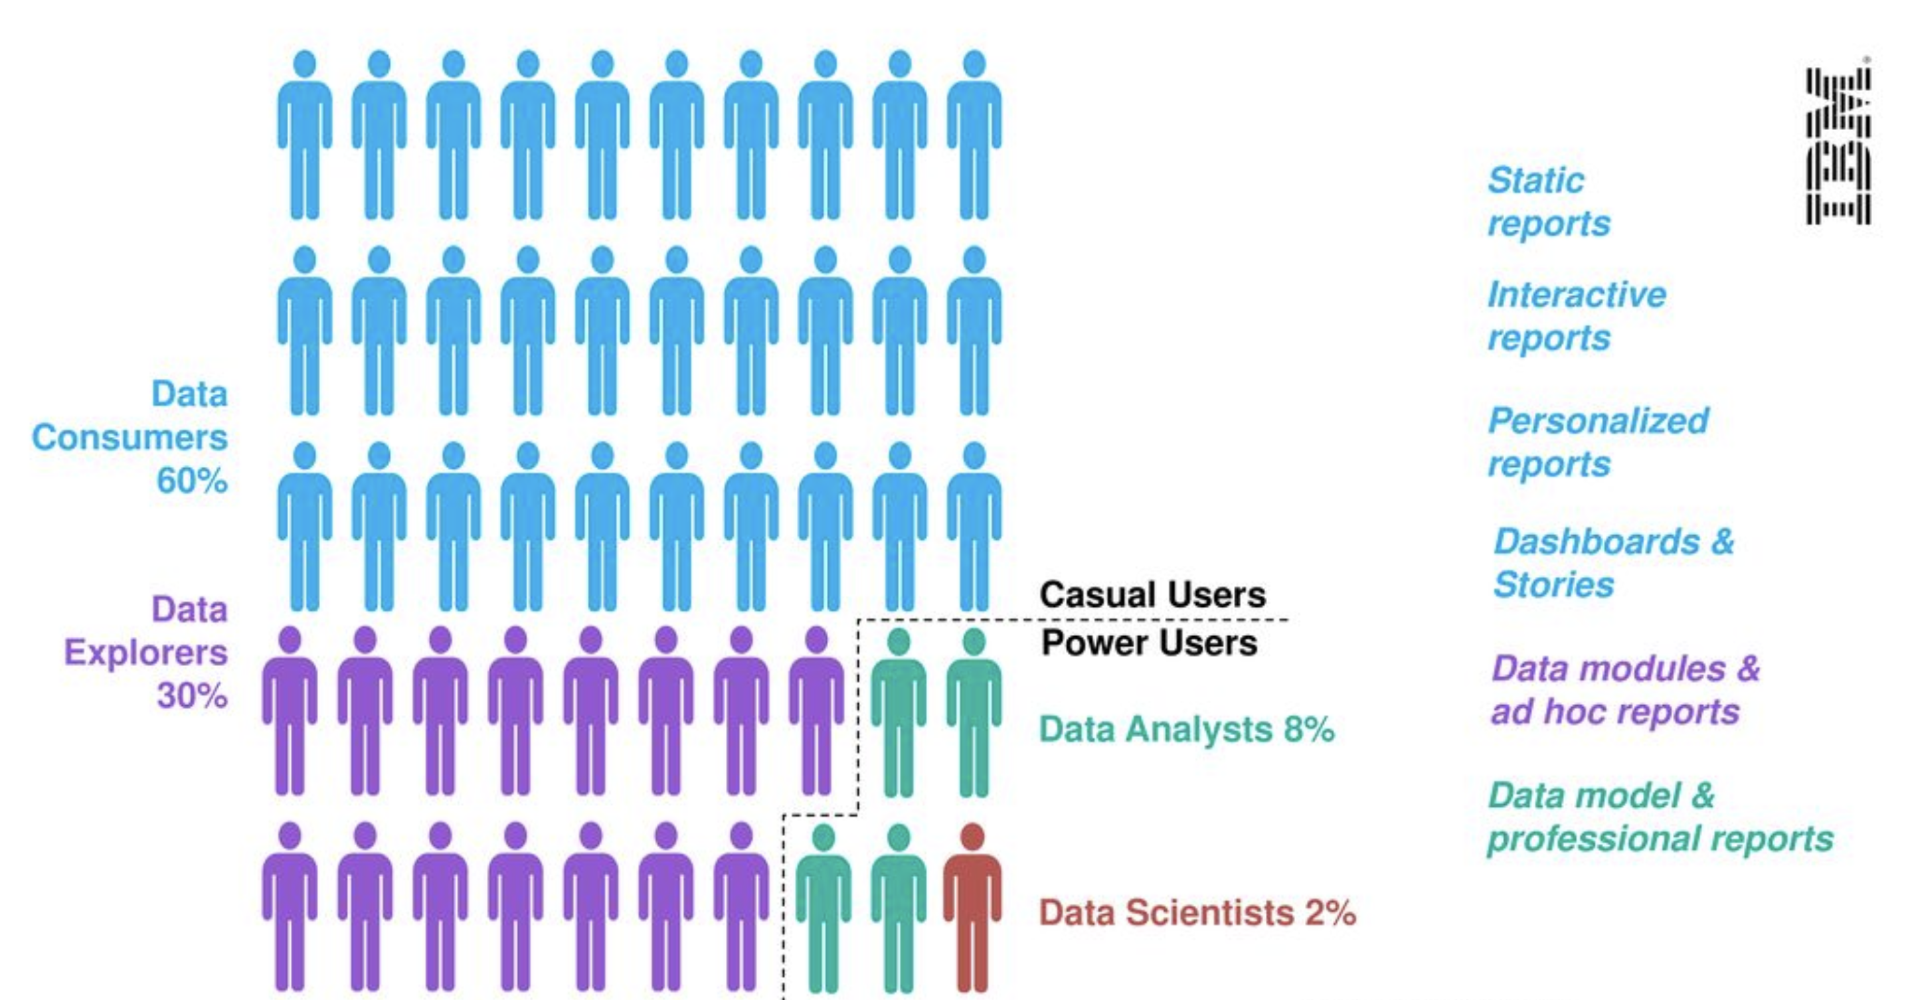
User Community today

Slide 4
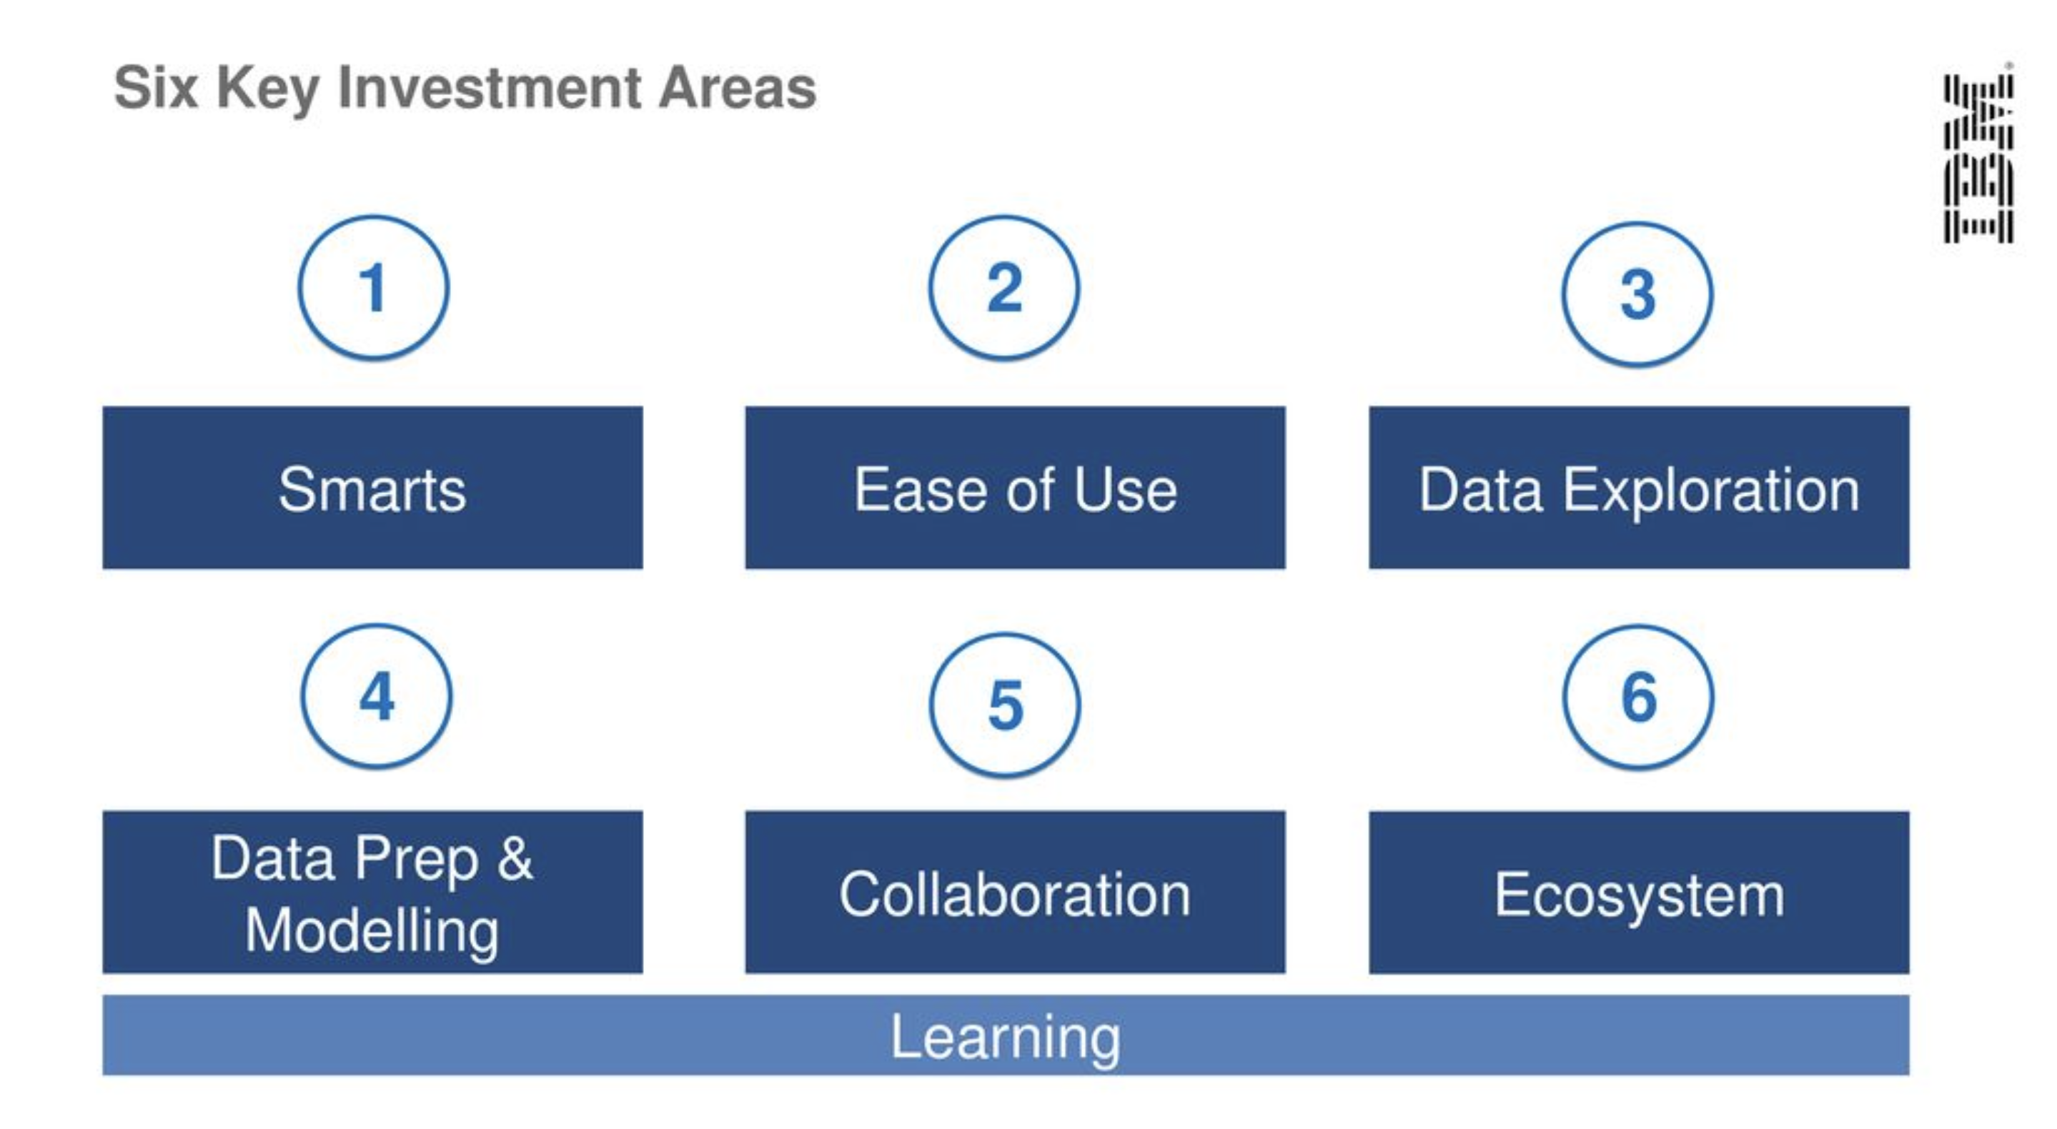

Slide 5
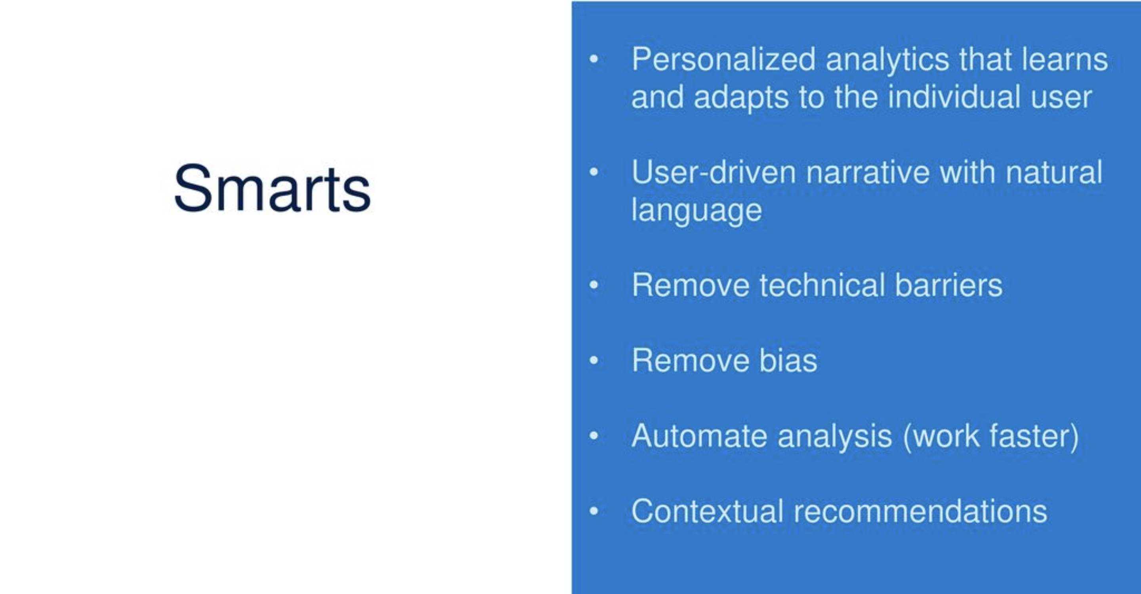

Slide 6
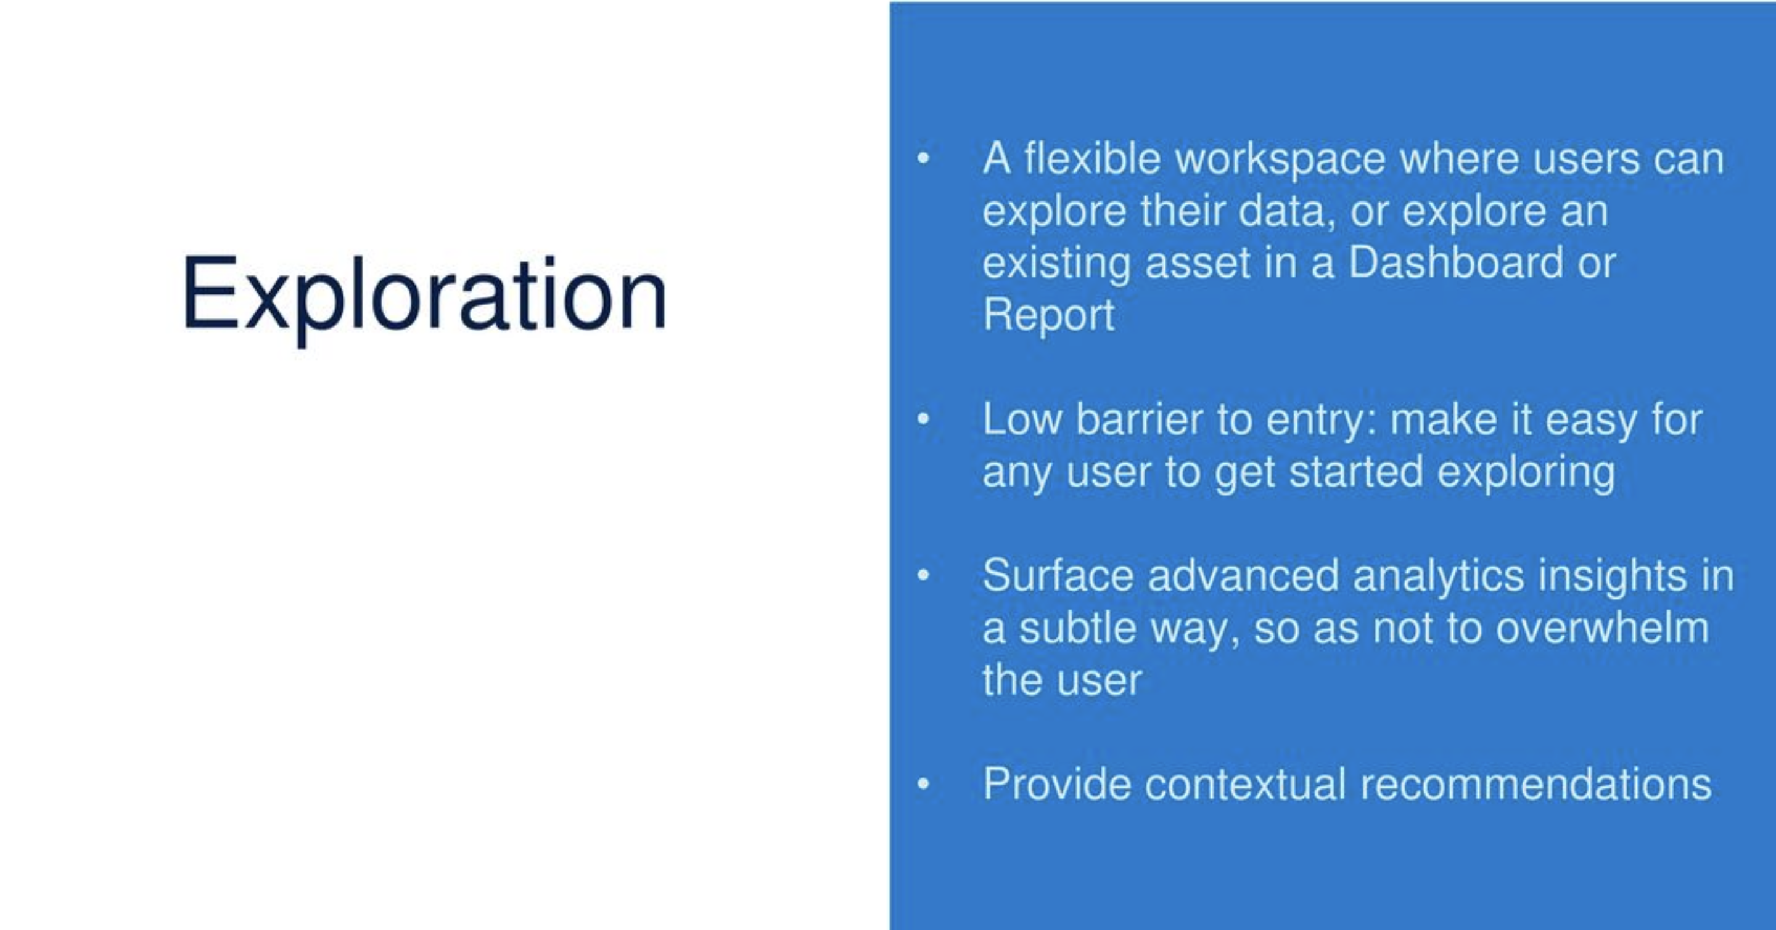

Slide 7
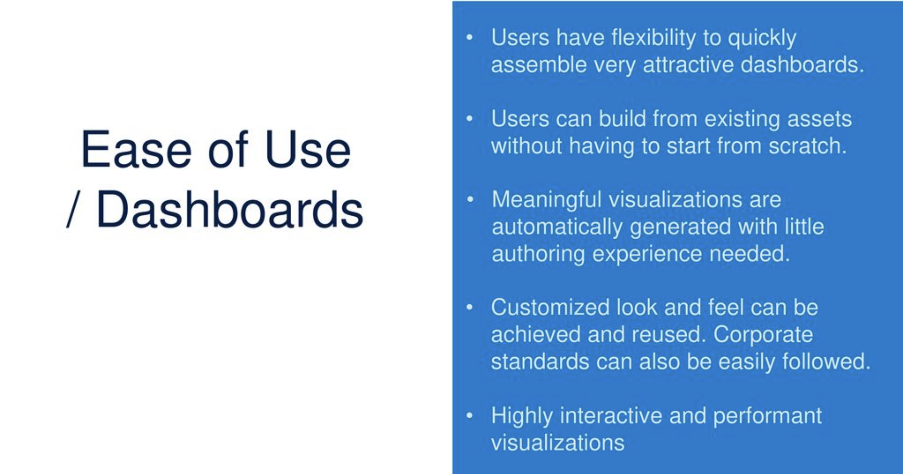

Slide 8
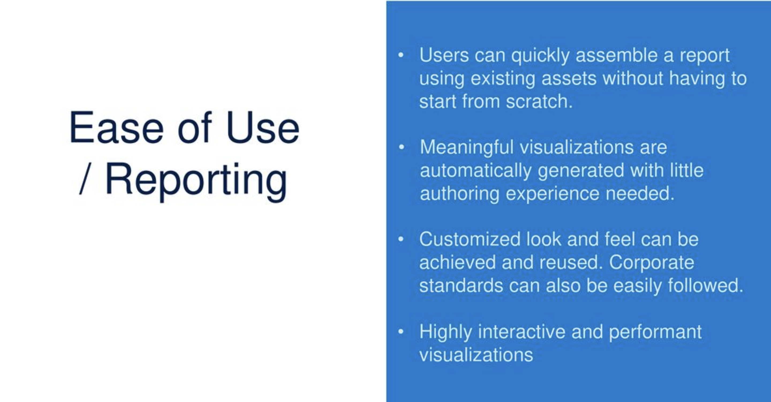

Slide 9
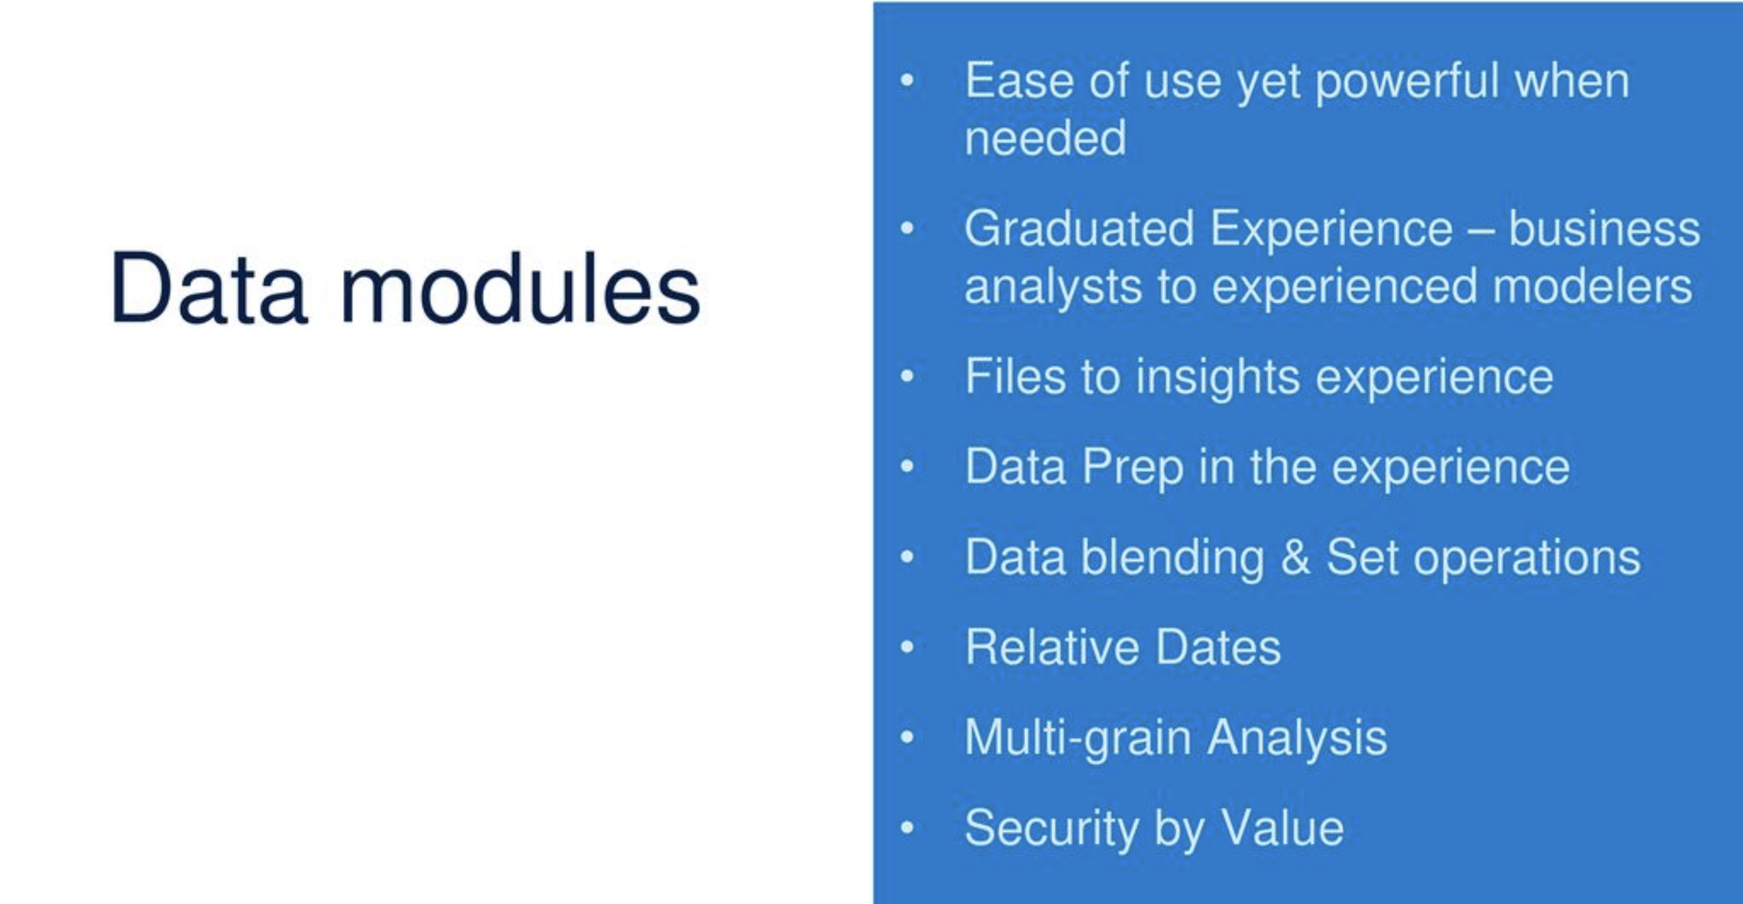
Container

Slide 10
Integrate with third party collaboration platforms(ex:Slack,Microsoft Teams…)
Share insights in context -
-> Messaging and Discussion
-> Share assets (dashboard, report..) as an image
Follow assets and other people
Tailor notifications to personal needs
Leverage smarts to suggest new content and users to follow
Collaboration

Slide 11
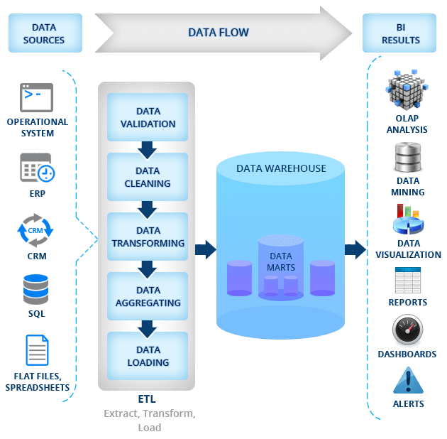
Working

Slide 12
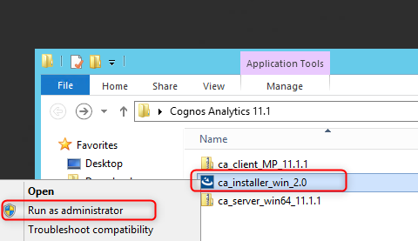
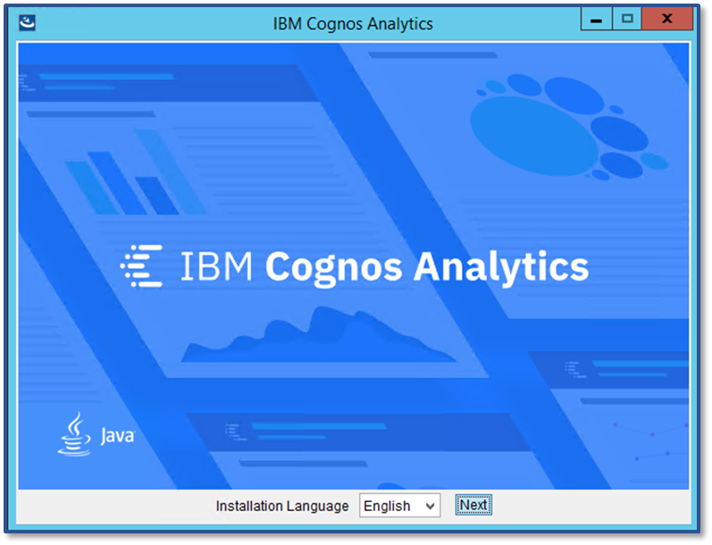
Installation:
Preparing to Install
Before you install Cognos Analytics, it is recommended to review the below checklist to make your install a success:
Review of the IBM Software Compatibility Reports page
Minimum of 8 GB of available Disk is required for Installation (This may vary based on components being installed)
Backup of your Cognos Content Store
Right click on ca_Installer_win_2.0 and select Run as administrator
Once the installation window loads select your desired installation language and click Next

Slide 13
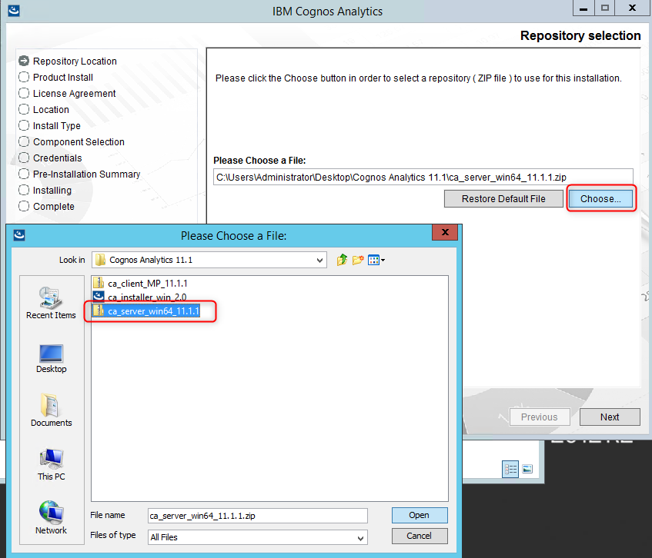
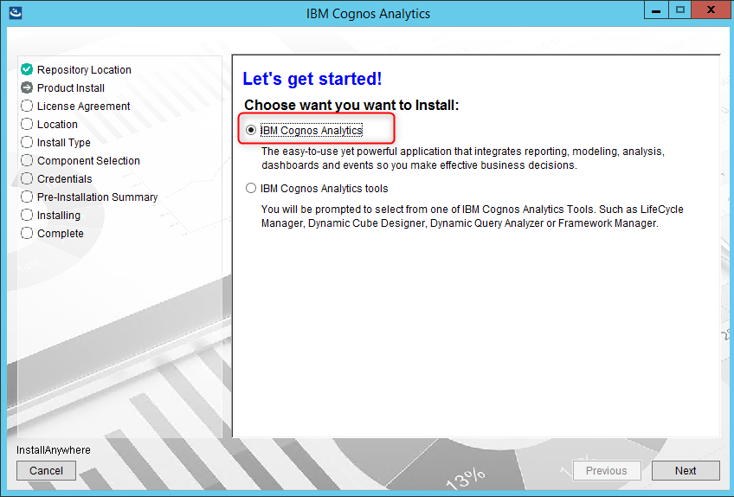
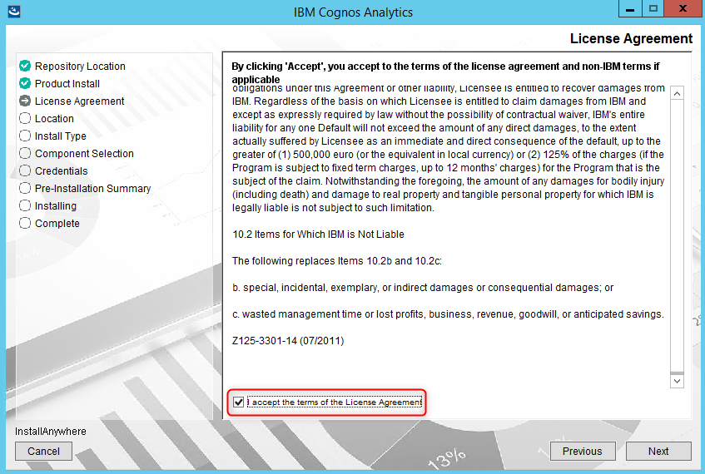
Click Choose and browse to the server repo (compressed file) and click Open and then Next
Select IBM Cognos Analytics and click Next
Review and accept the licenses agreement and click Next

Slide 14
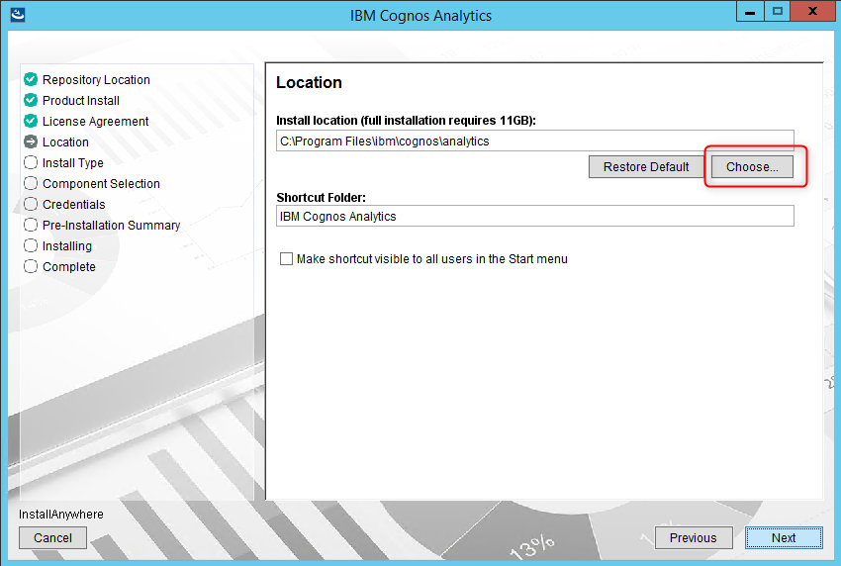
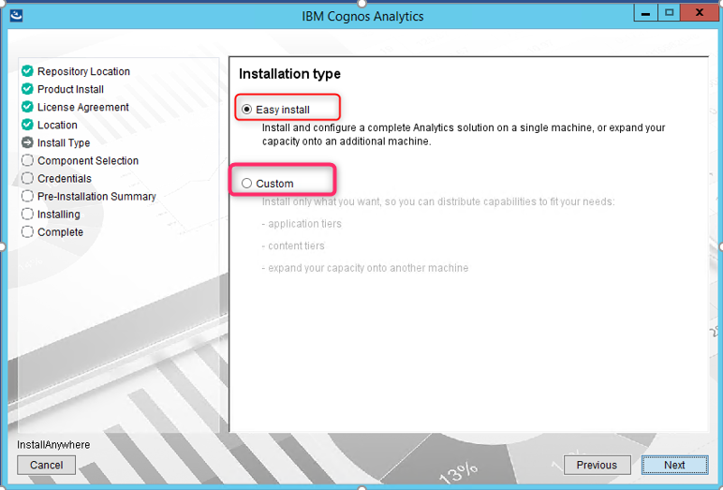
If you are doing an over-the-top install skip to Perform an Over The Top Install section of this document
If this is a new install and not over the top you will have the option to select from an Easy Install or Custom
Choose the location where you would like the Cognos Analytics application to be installed and click Next

Slide 15
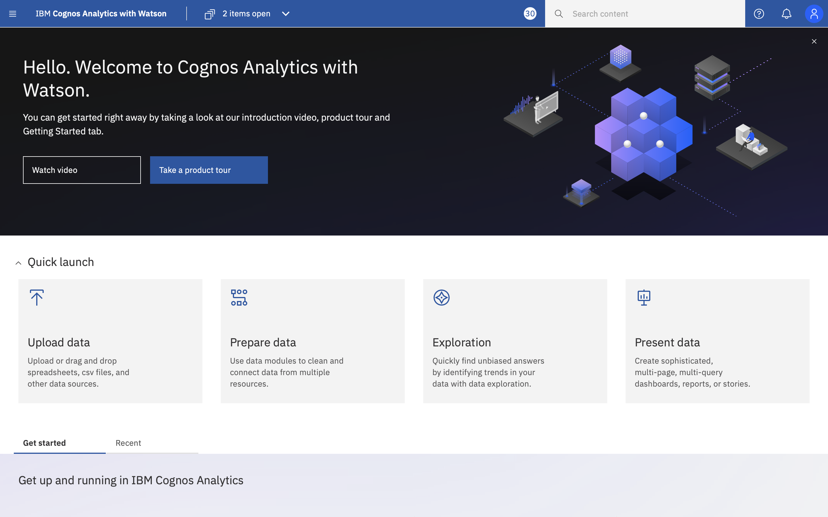
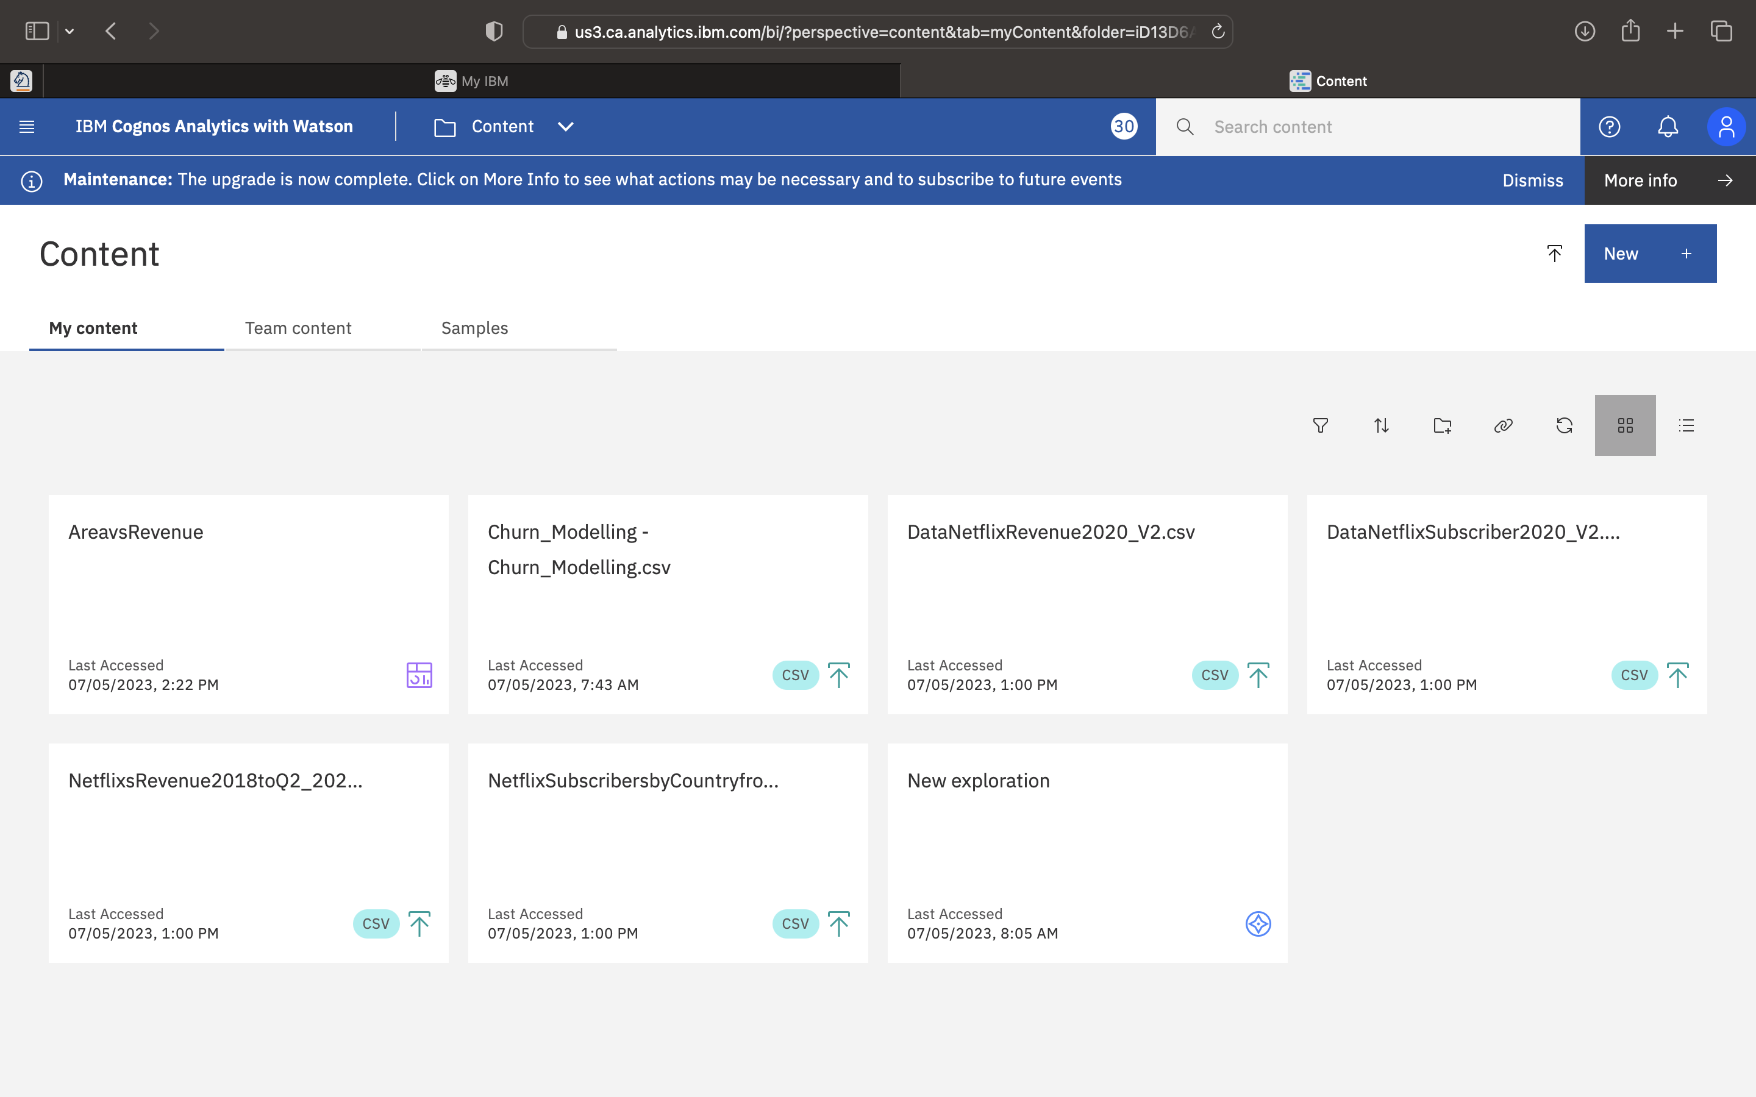
Sample Execution
Dashboard:

Slide 16
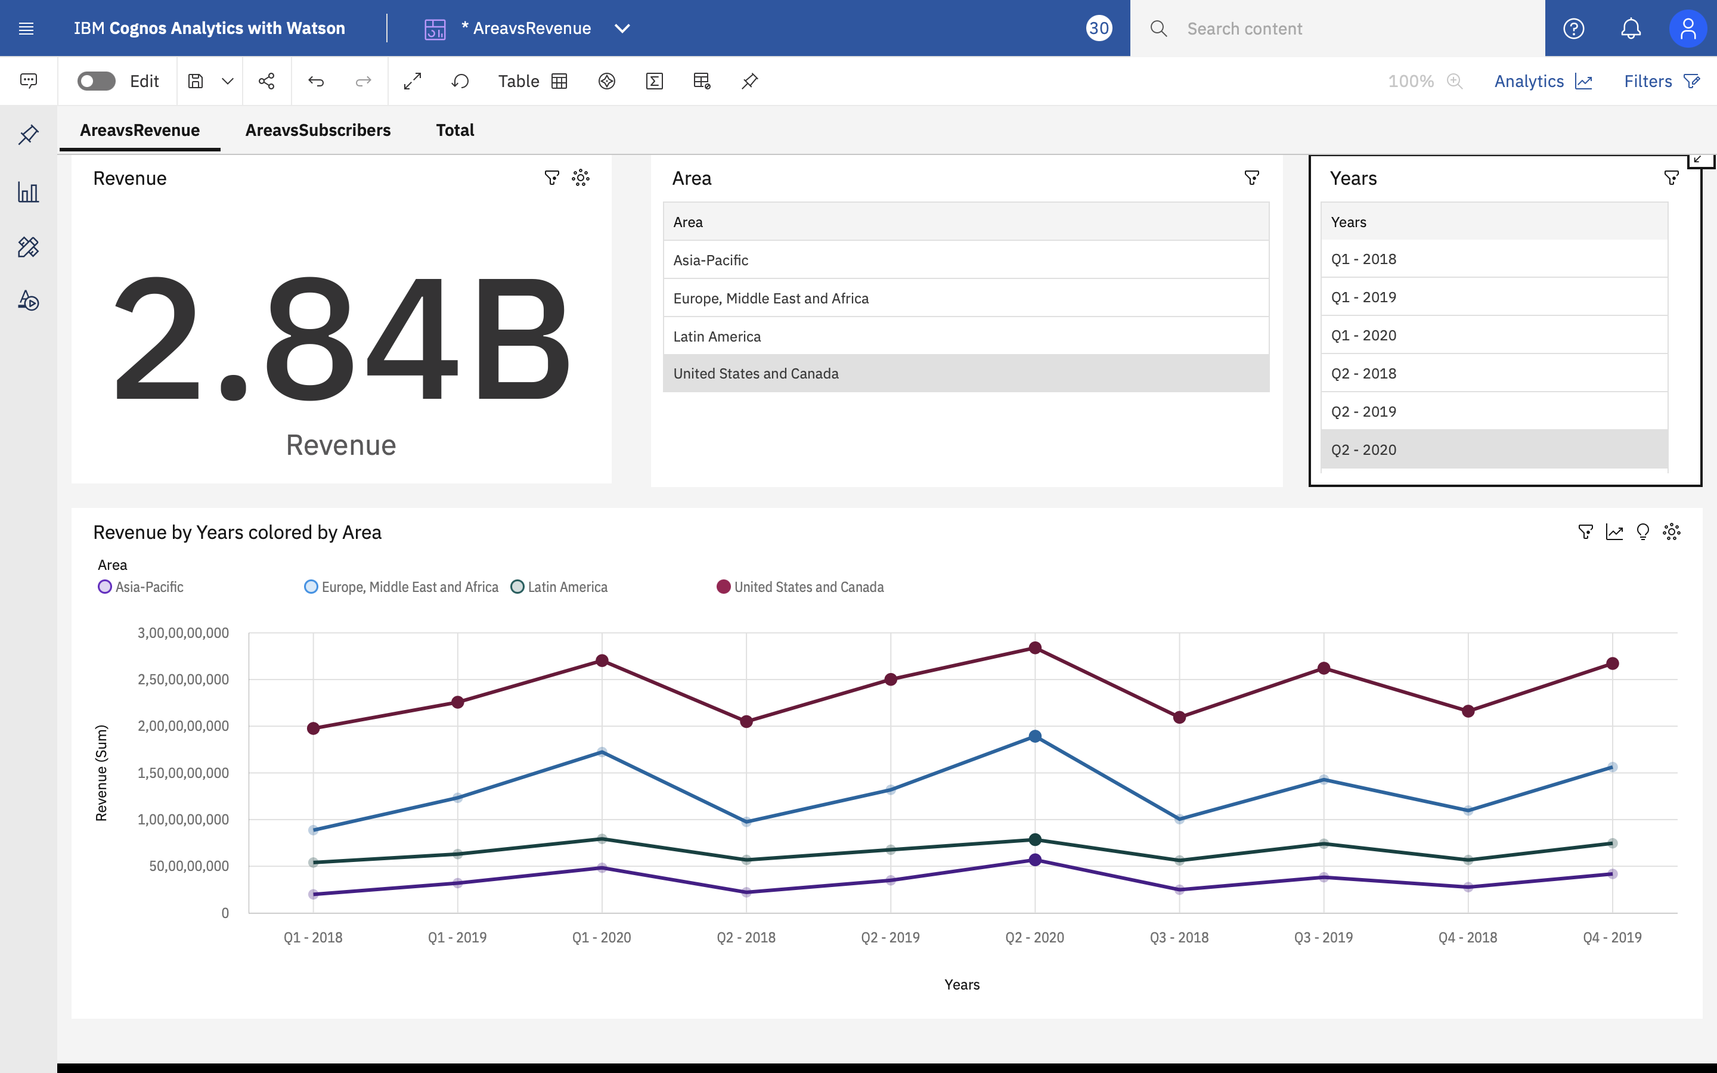
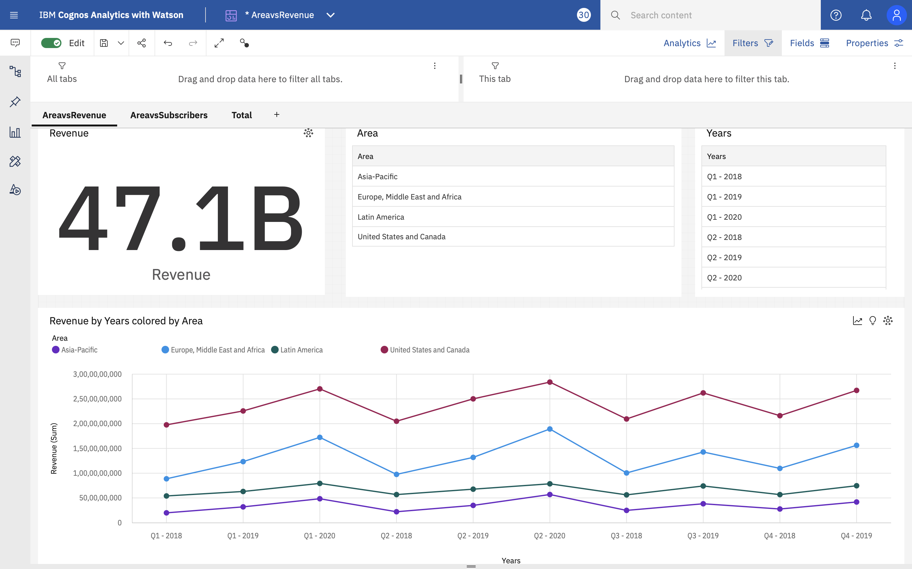
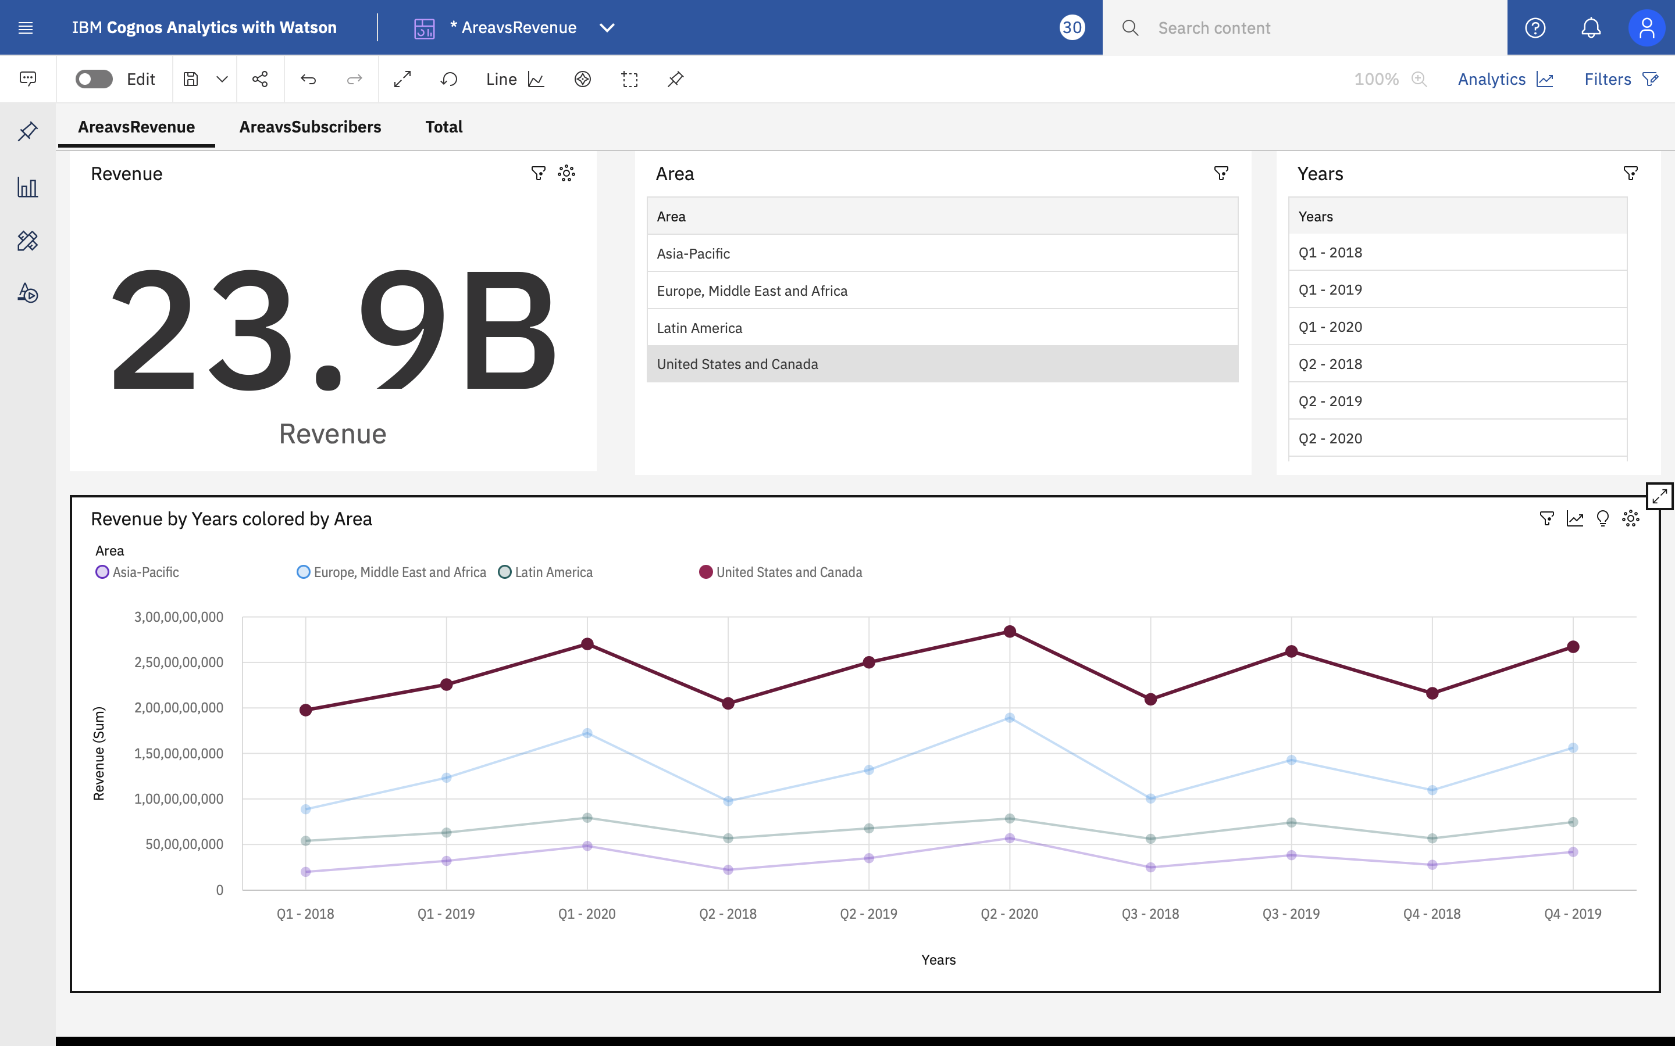
Analysis Based on Data Netflix Revenue:

Slide 17
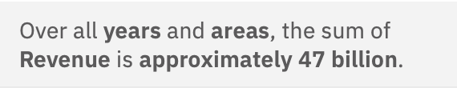
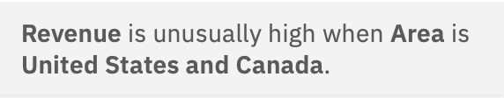
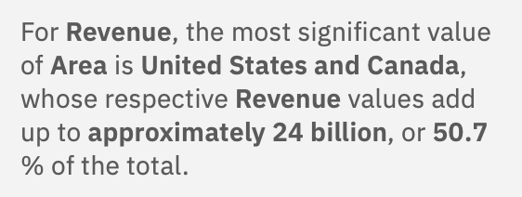
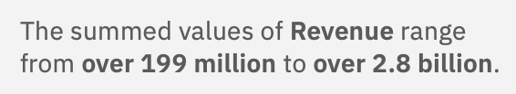
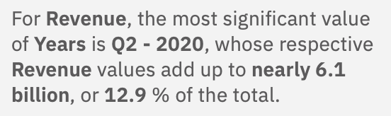
Outcome:

Slide 18
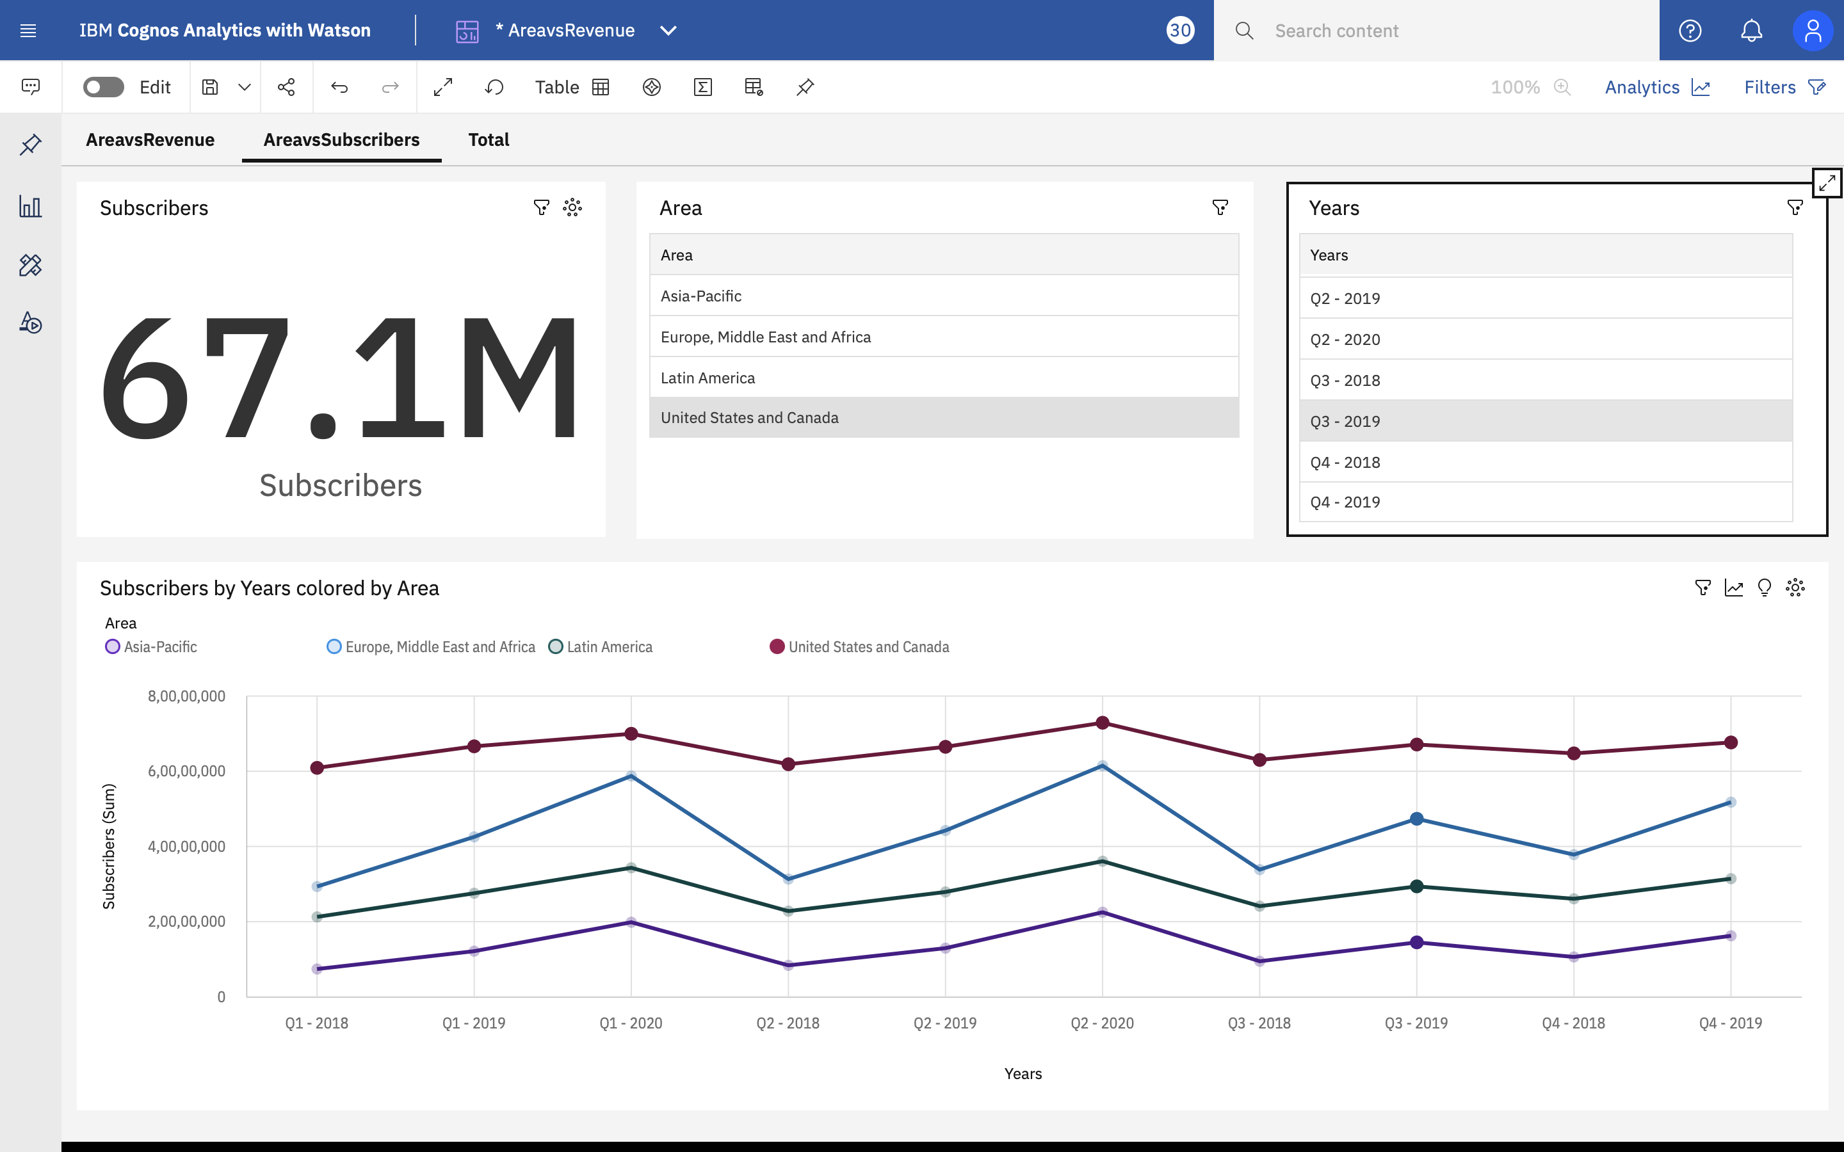
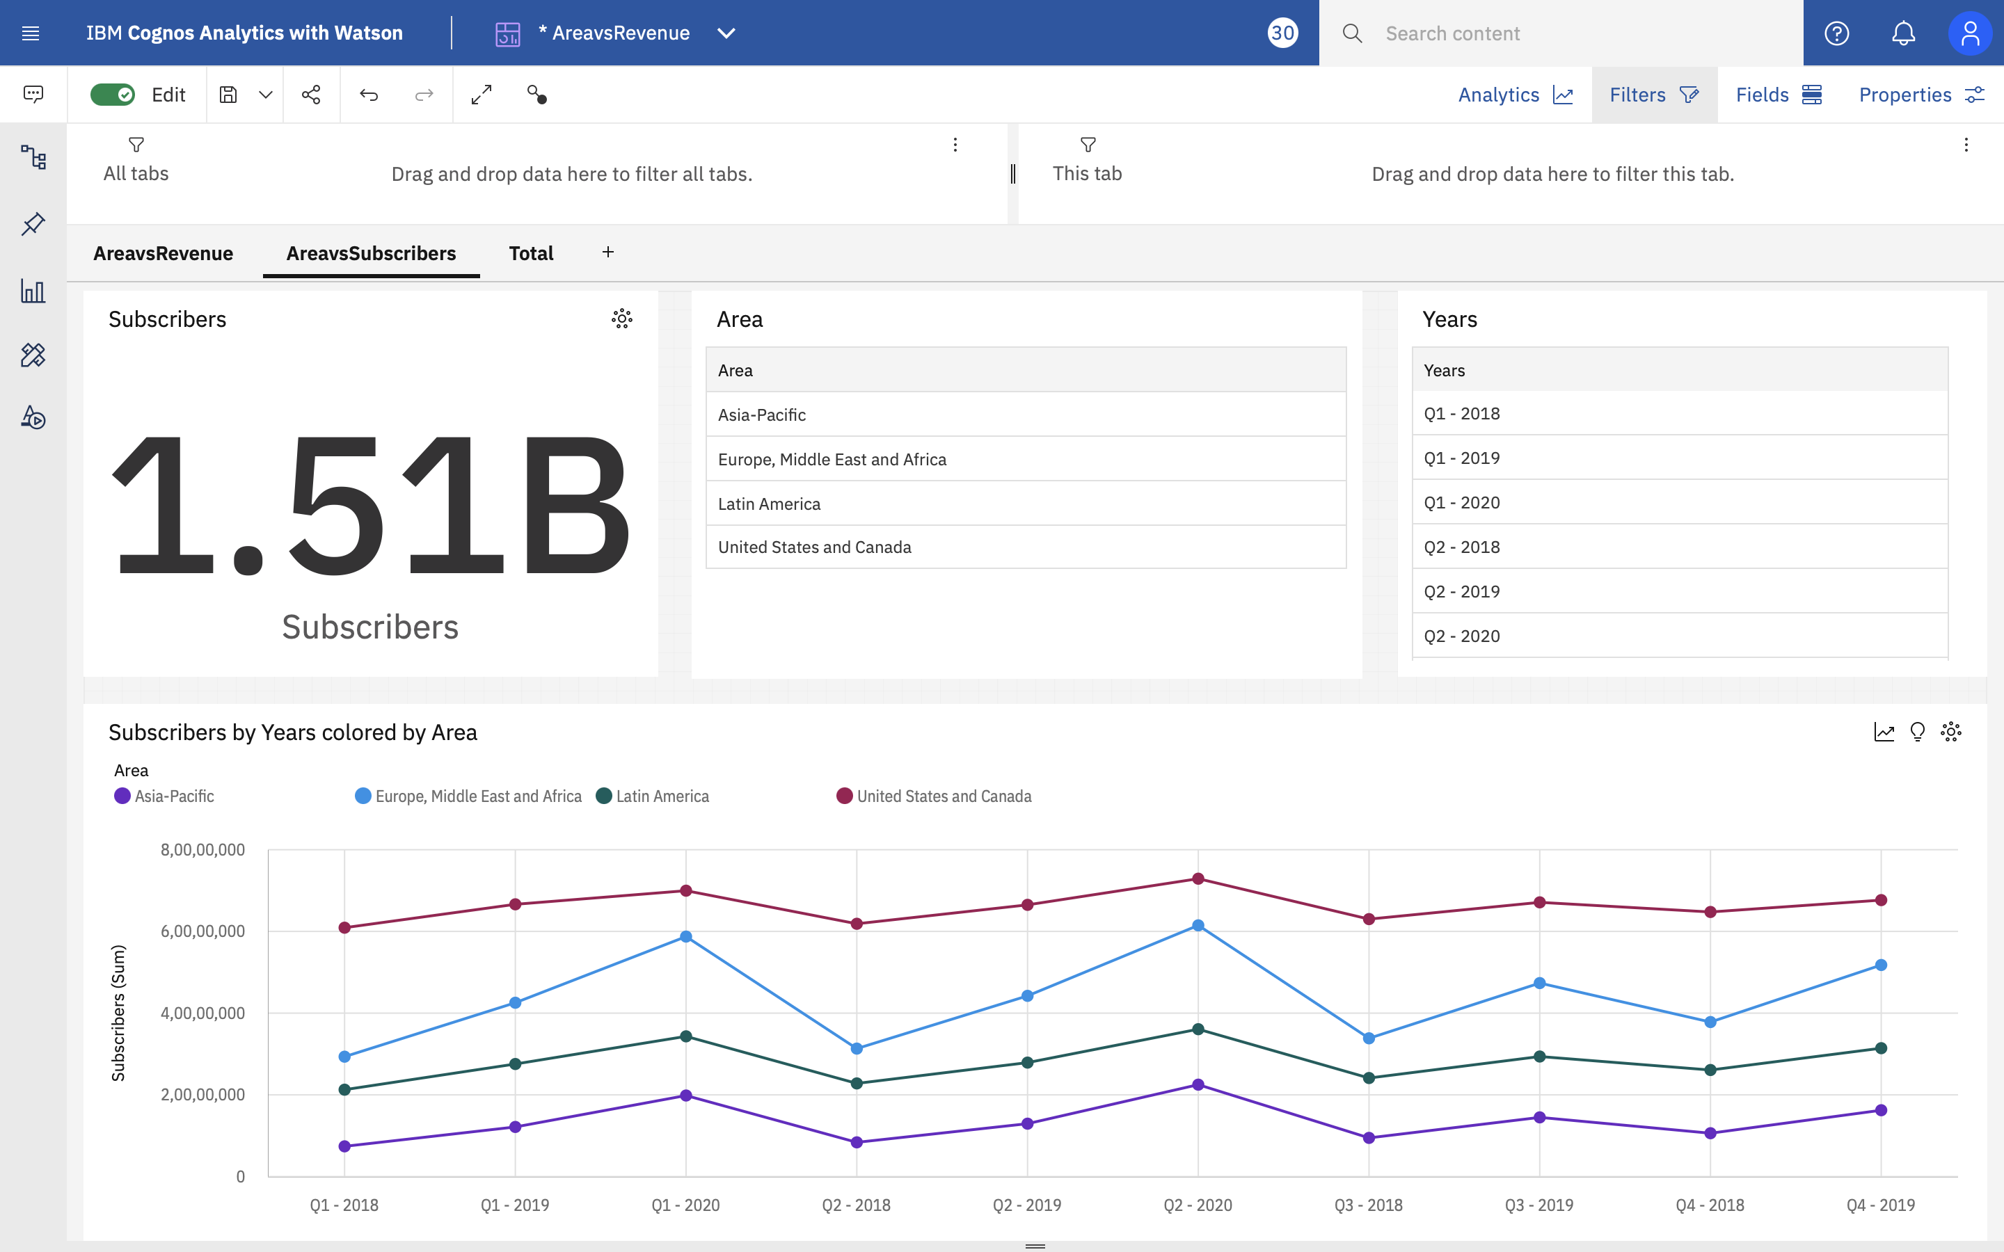
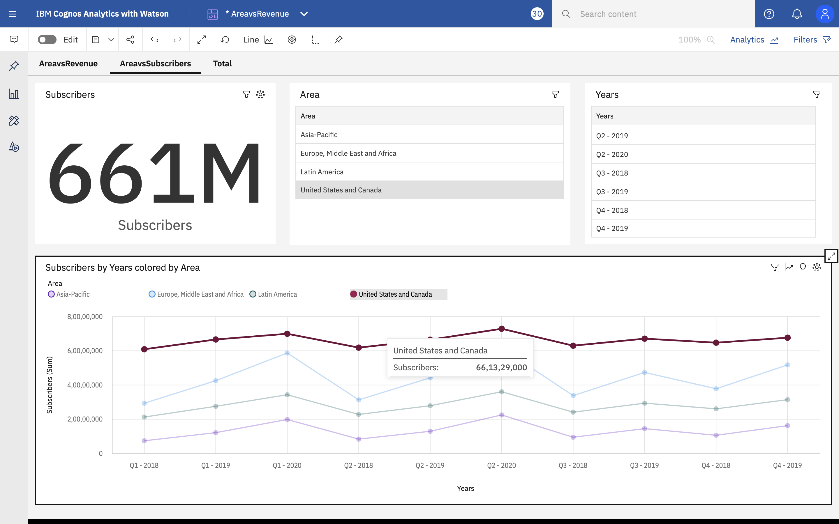
Analysis Based on Data Netflix Subscribers:

Slide 19
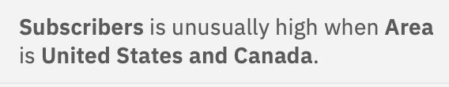
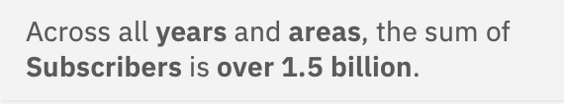
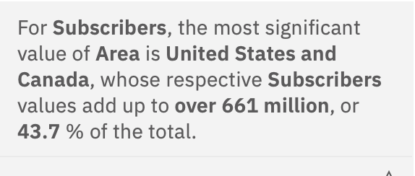
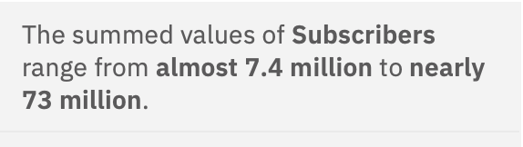
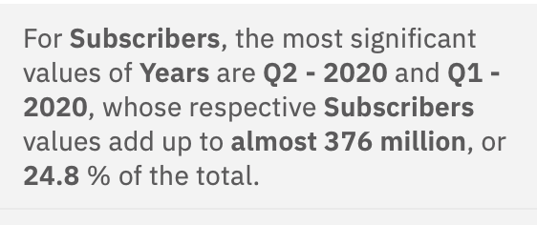
Outcome:

Slide 20
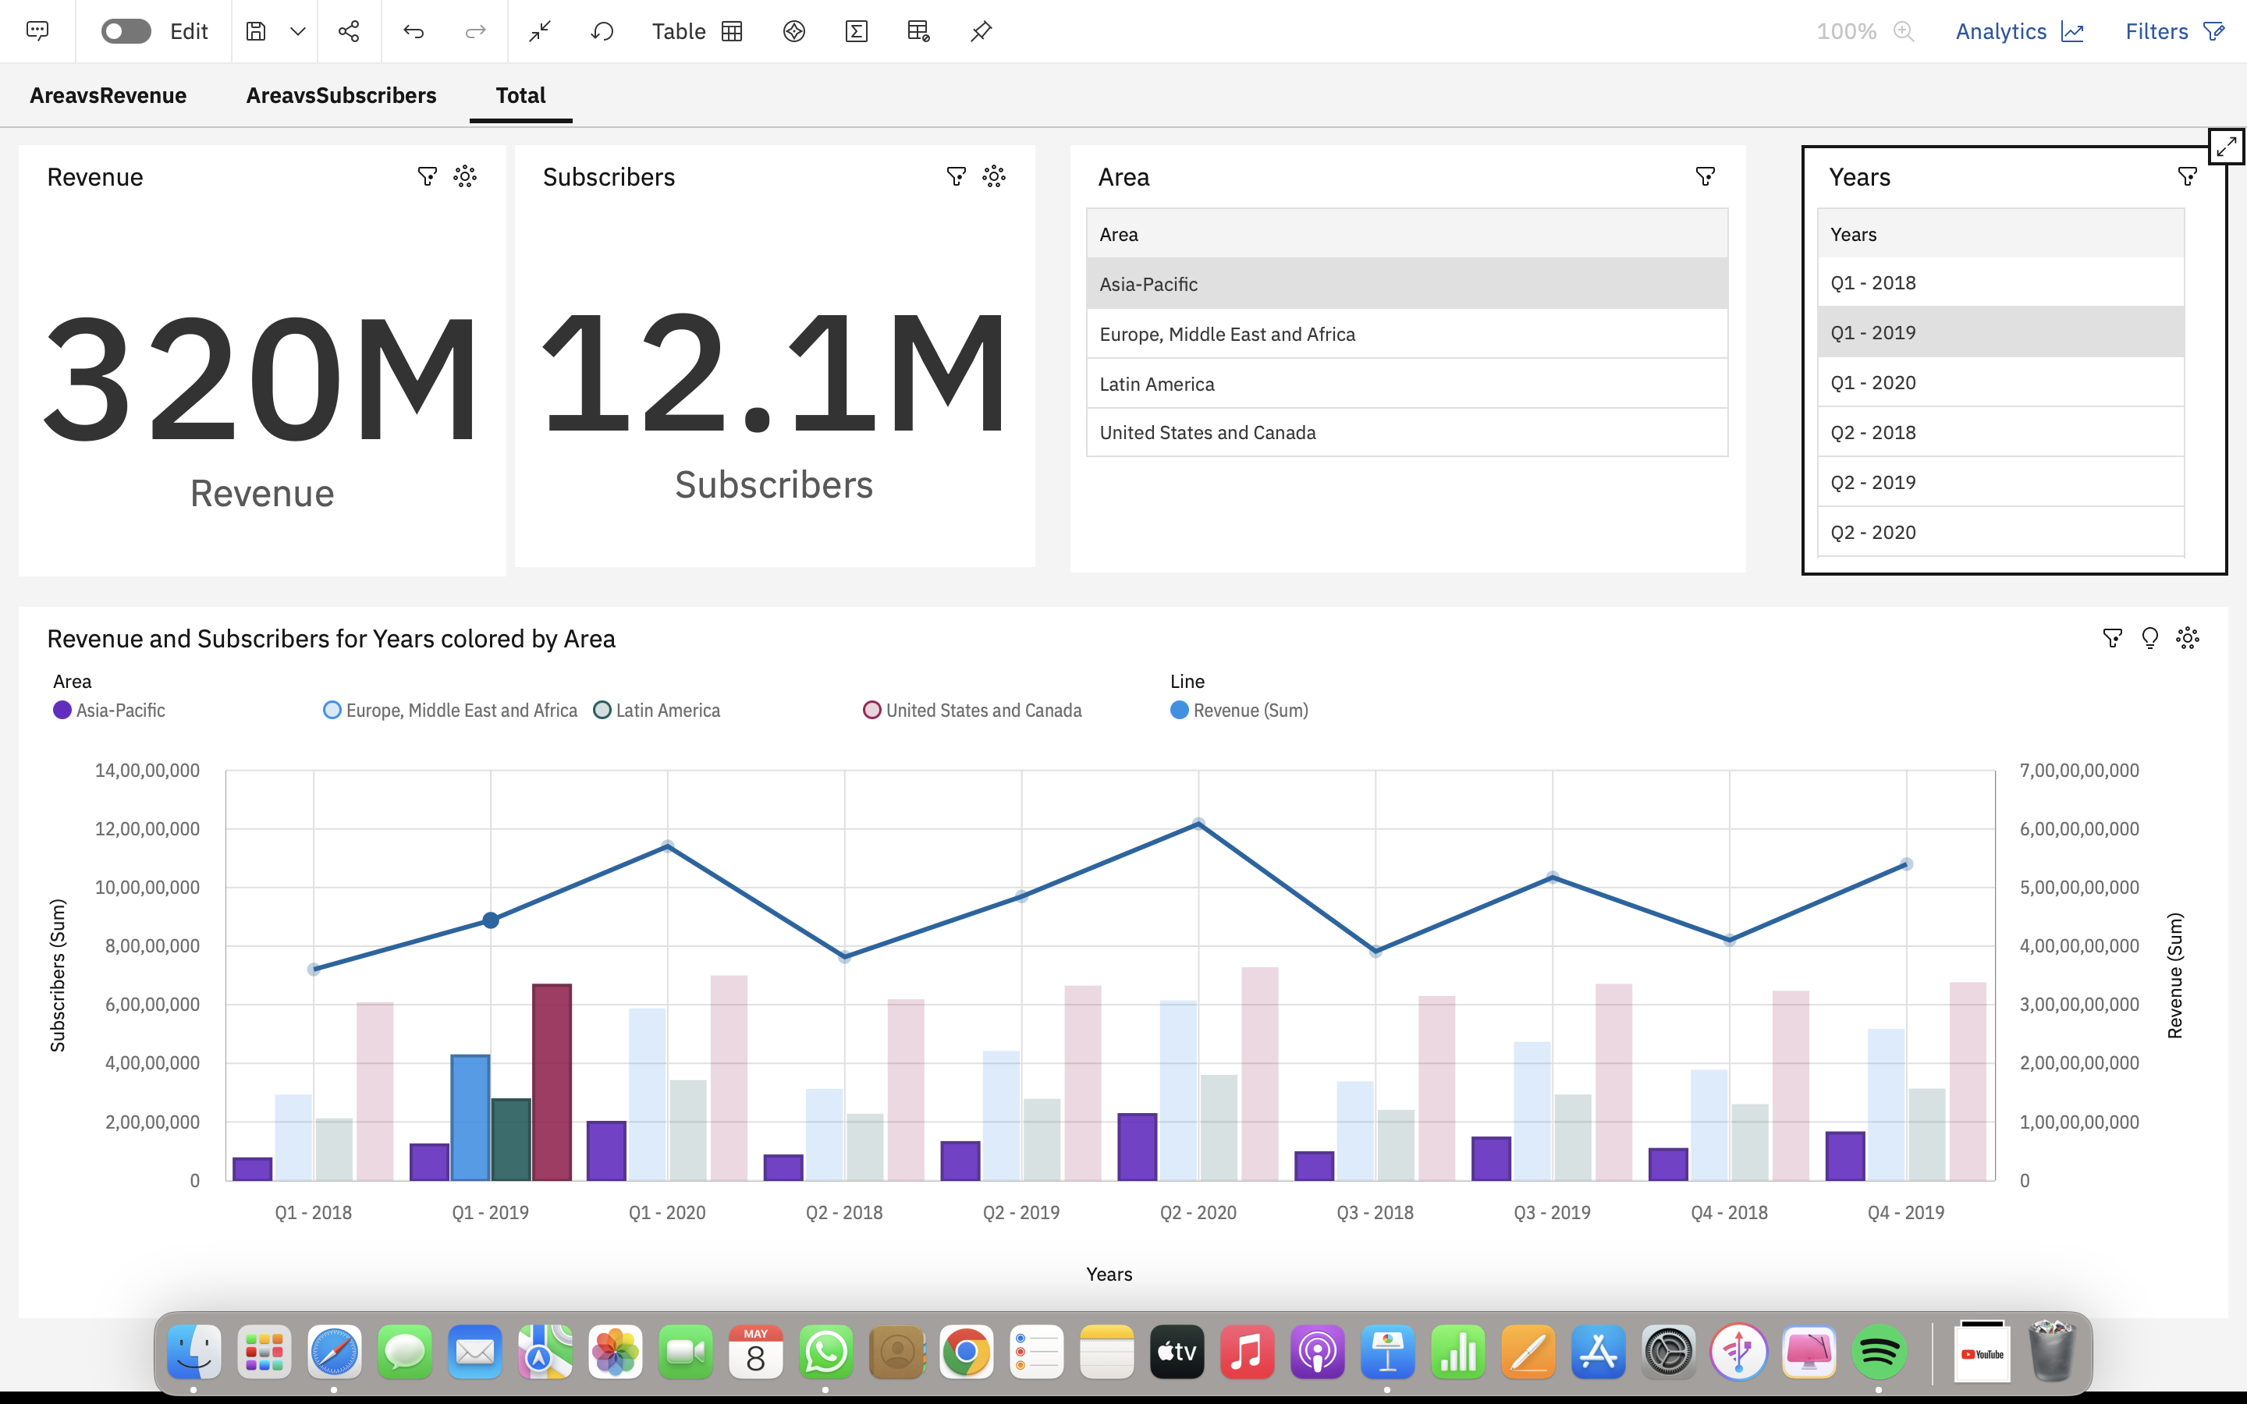
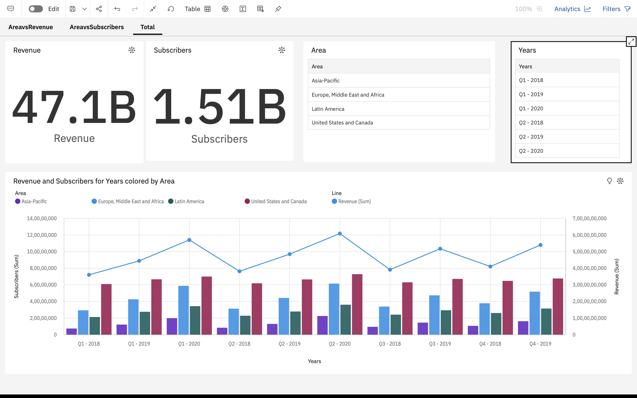
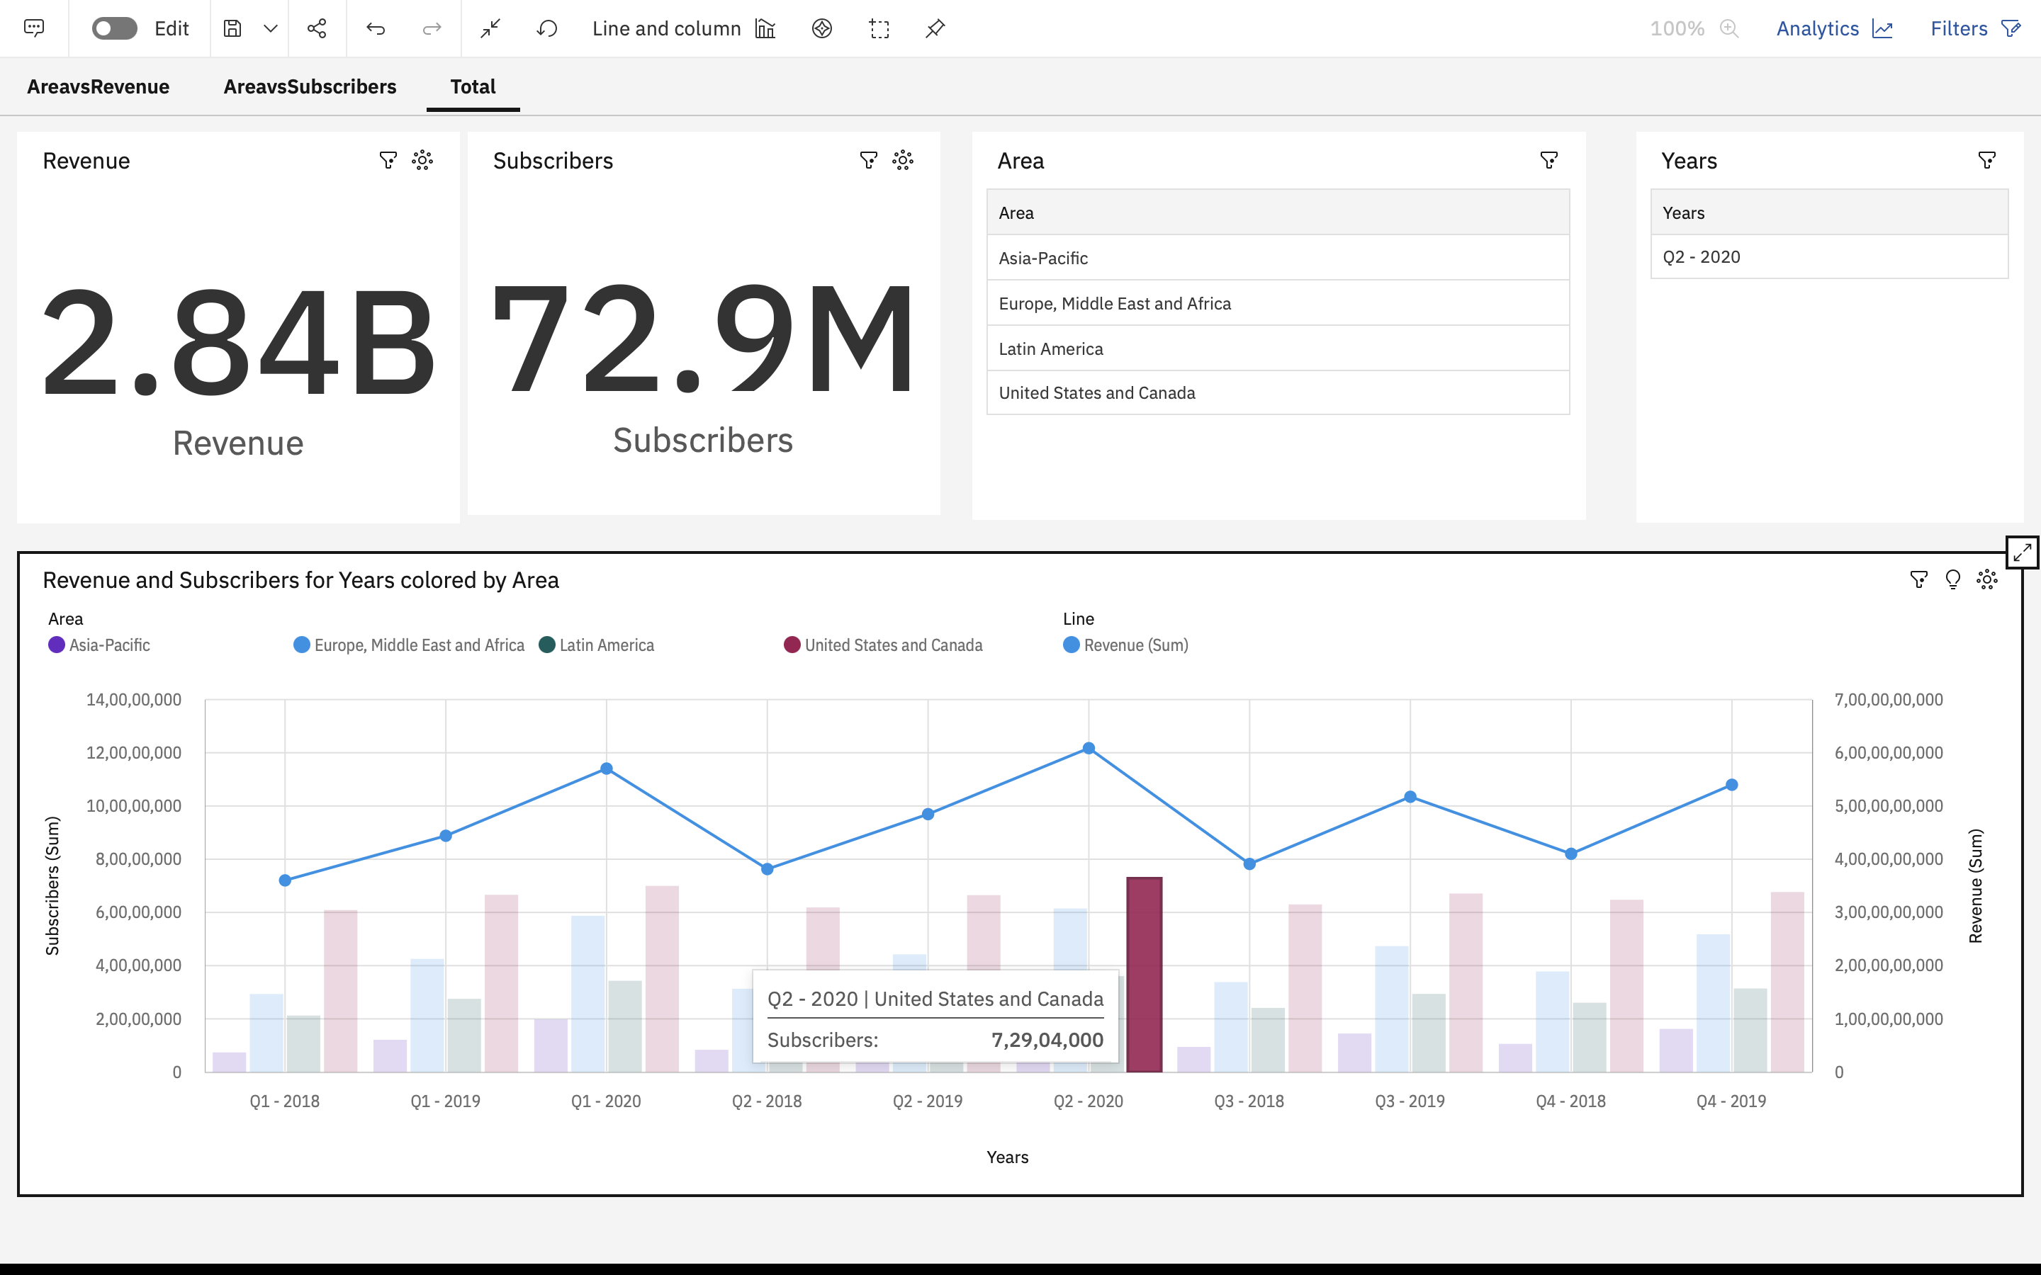
Analysis Based on Data Netflix Revenue and Subscribers:

Slide 21
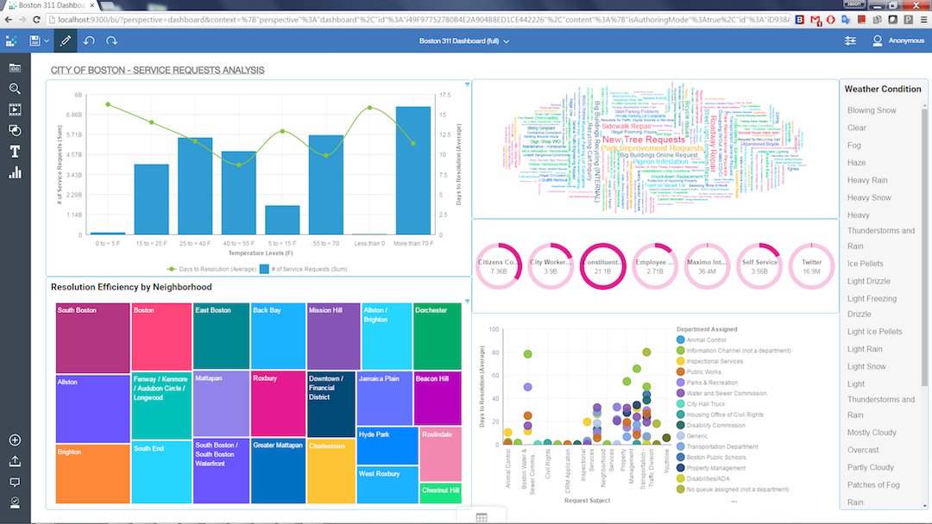
Outcome
Data-driven decision-making
Improved reporting and visualization
Self-service analytics
Advanced analytics capabilities
Enhanced collaboration and sharing
Mobile and real-time analytics
Governance and security

Slide 22
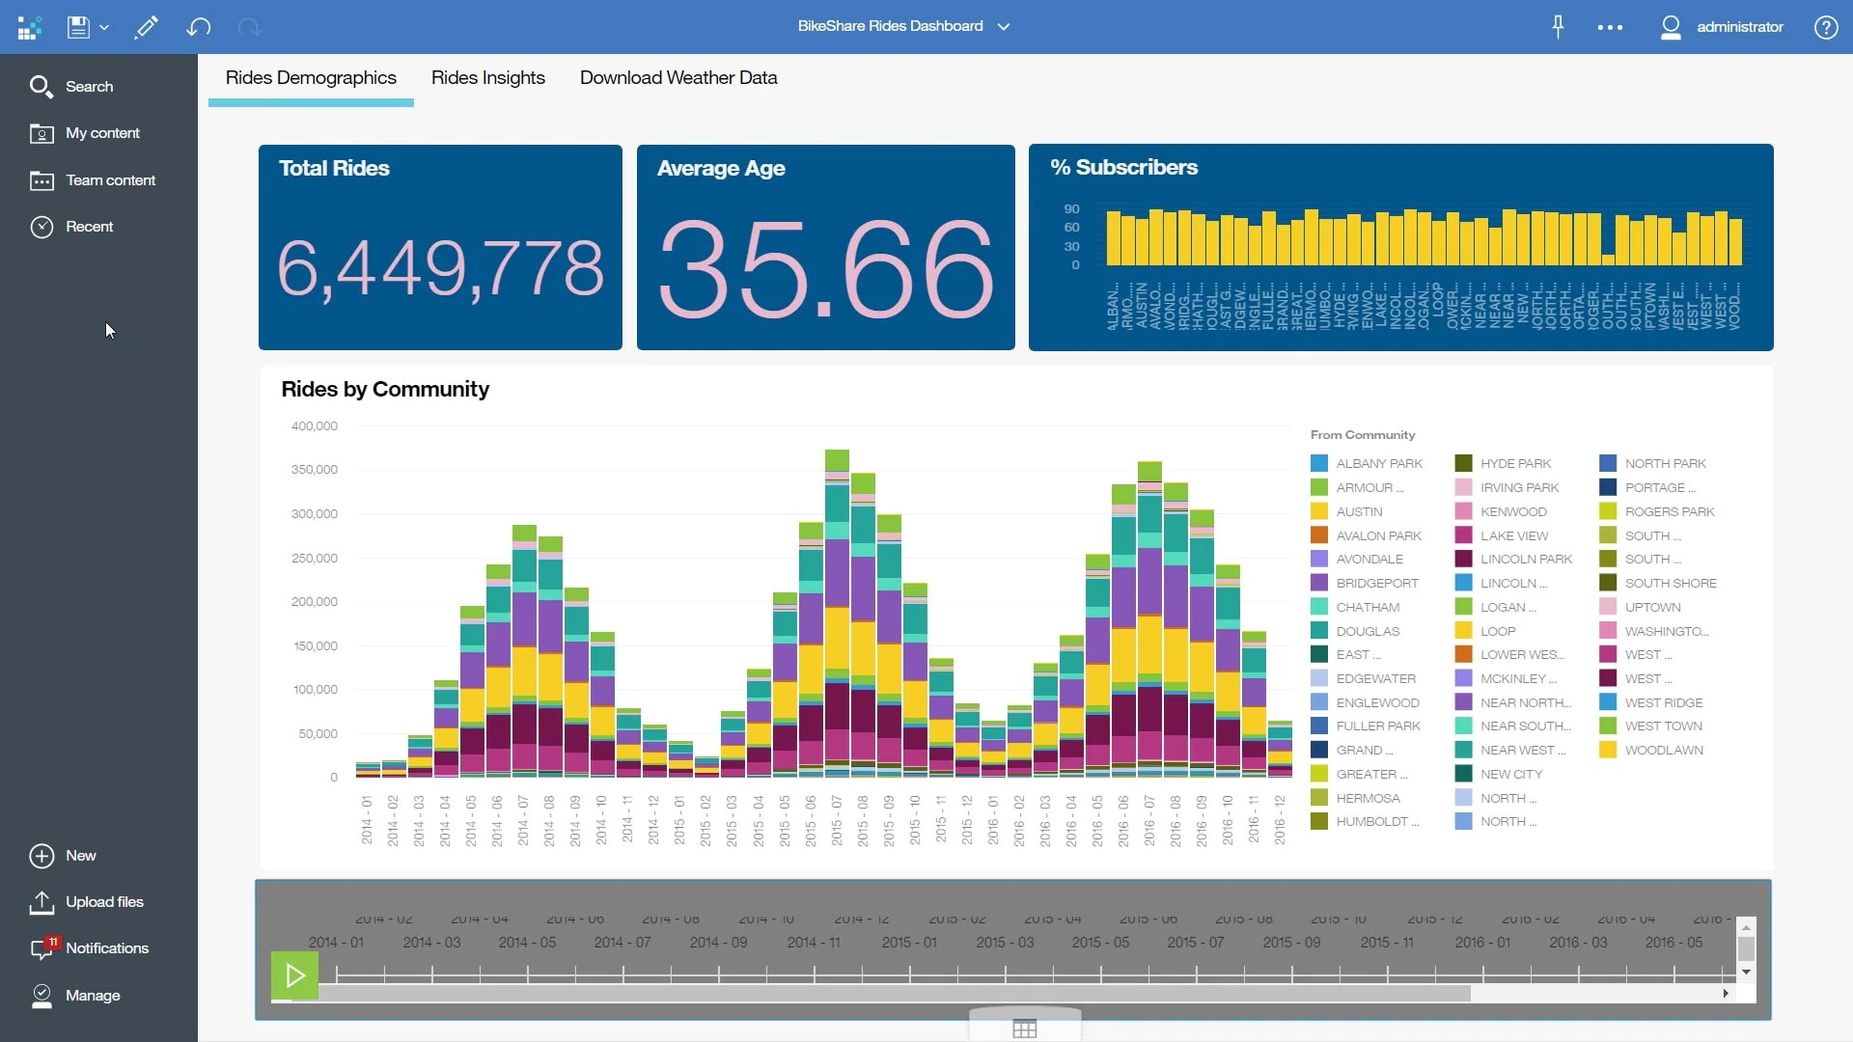
How its Better?
Comprehensive and Integrated Platform
Advanced Analytics Capabilities
Self-Service and User-Friendly Interface
Robust Collaboration and Sharing
Enterprise-Grade Security and Governance
Scalability and Integration
Continuous Innovation and Support

Slide 23
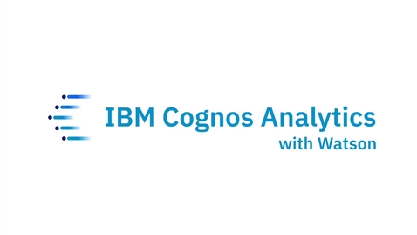
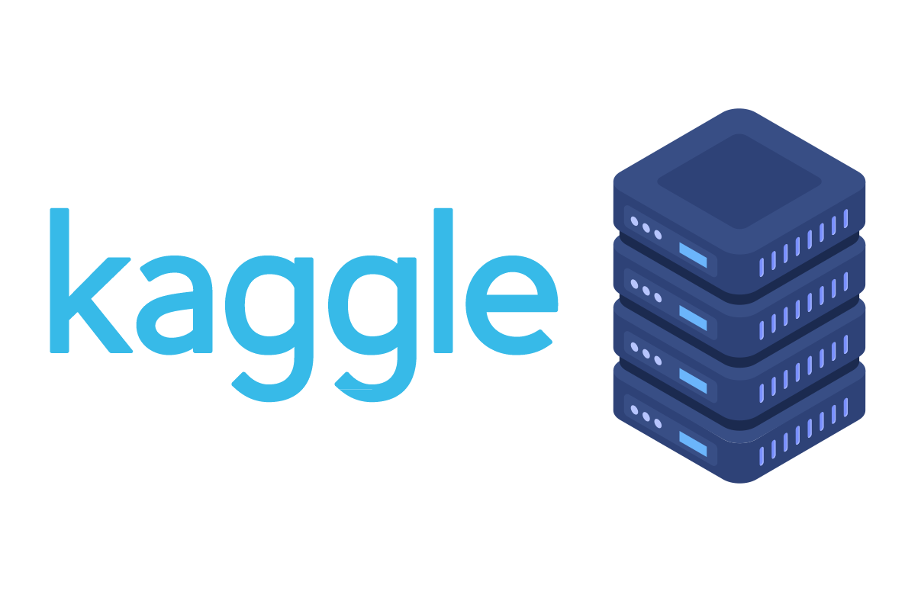


References
https://www.ibm.com/products/cognos-analytics
https://www.ibm.com/in-en
https://www.kaggle.com/
https://www.youtube.com/

